Slide 1

SPECIALITIES
Designed, rolled out, and managed 5,000+ hosts with Ansible and Chef. Implemented a Continuous Delivery pipeline with Docker, Jenkins and GitHub and AWS AMI’s, whenever a new GitHub branch gets started, Jenkins, the Continuous Integration server, automatically attempts to build a new Docker container from it, The Docker container leverages Linux containers and has the AMI baked in.
Experienced in deploying and managing cluster of containers using various Orchestration tools in on-prem (OpenShift/Kubernetes/Docker Swarm) and cloud (ECS/EKS/AKS/GKE).
Designed large & complex applications for various clients.
Passionate about Automating Configuration Management with Ansible/Chef and setting up Kubernetes or OpenShift cluster either on On-Prem / Cloud.
Specialist in Cloud and DevOps
Senior Architect with 14+ years of IT experience.
Solution Architect with 8+ years of hands-on experience supporting, automating, and optimizing mission critical deployments in several cloud platforms, leveraging configuration management, CI/CD, and DevOps processes.
Mamta Jha
Cloud Architect / Author / Co-Founder: TechScalable
Learn more about Mamta Jha:
https://www.linkedin.com/in/mamta-jha/

Slide 2

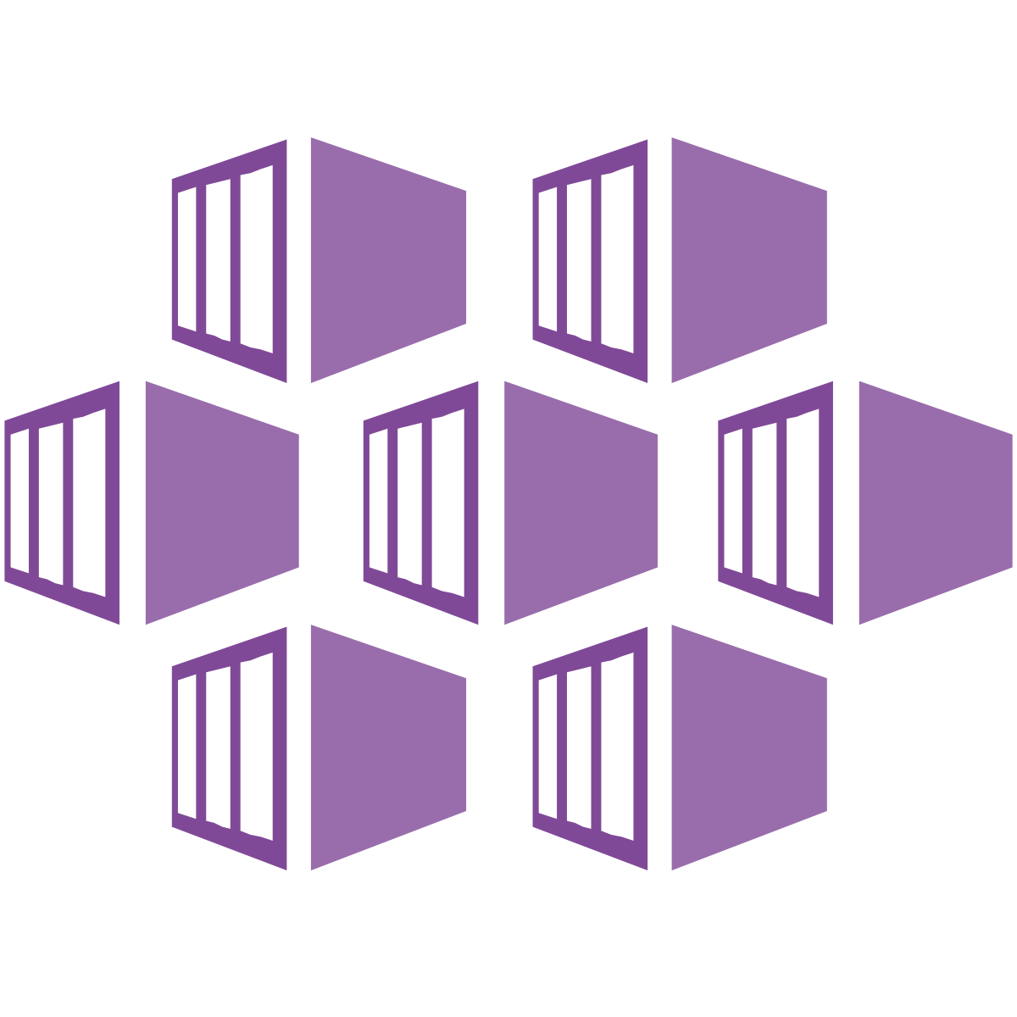
Azure DevOps
Working with Microservices-based Apps
with
Azure DevOps and AKS

Slide 3
Agenda
Setup Azure AKS Cluster
Create a private Azure Container Registry
Azure SQL Server
Azure Repo used for Code Control
Azure Pipeline for Continuous Integration and Build
Azure Pipeline Release to deploy code to AKS

Slide 4
Deploying Infrastructure
Deploy Kubernetes to Azure (AKS):
az aks create --resource-group <rg> --name <unique-aks-cluster-name> --enable-addons monitoring --kubernetes-version <version> --generate-ssh-keys --location <region>
Deploy Azure Container Registry (ACR):
az acr create --resource-group akshandsonlab --name <unique-acr-name> --sku Standard --location <region>
Grant AKS-generated Service Principal access to ACR:
az role assignment create --assignee <AKS> --role acrpull –scope <ACR>
Create Azure SQL server and Database:
az sql server create -l <region> -g <rg> -n <unique-sqlserver-name> -u <sqladmin> -p <passwd>
az sql db create -g <rg> -s <unique-sqlserver-name> -n <dbname> --service-objective S0

Slide 5









CI/CD End-to-End
CD
CI

Slide 6

Kubernetes Service
Load Balancing
Worker Node 1
Worker Node 2
Service A
10.10.9.2
Pod A
Pod A
C1
C1
10.10.10.3
10.10.10.4
kubelet
kubelet
Docker
Docker

Slide 7
Azure DevOps - Benefits
All in One
Simplified Interface
Easy to integrate with other tools
Has On-Prem and Cloud flavor
Supports – Any Language, Any Platform, Any Cloud
Reliable, Scalable and Secure

Slide 9
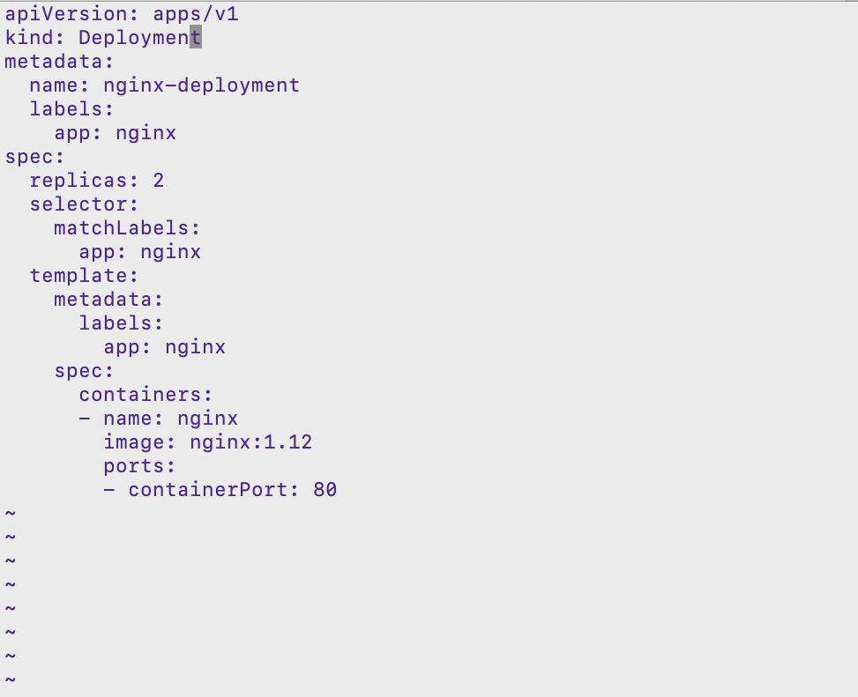
Kind: Deployment
Deployment Controller defines the state of Deployment Objects, like Pods and ReplicaSets
Deployments are used to create and deploy, scale, monitor and roll back
Manage the state of Pods and ReplicaSets on the system
Make application highly available, scalable and self-healing

